Slide 1
New World Athletics
Booster Club

Slide 2
Mission Statement
Our mission is to support the success and development of our cheer athletes by fostering a positive, inclusive environment and building a strong community. We aim to provide opportunities for financial growth by assisting athletes in raising funds for their cheer journey while helping to offset costs by purchasing mandatory items and assisting support for gym needs. Together, we strive to empower athletes to thrive on and off the mat, promoting teamwork and dedication while cultivating a strong sense of pride and unity within our cheer community.

Slide 3

The New World Booster Club does so much more than fundraising!!
- We are also here to support our athletes & coaches. By being a member of the New World Booster Club it allows you to not only participate in fundraisers, but we also sponsor events for the athletes, buy special gifts, and assist with end of the year events.
- The booster fee this year is $40 per family. If there is more than one child there will be an additional $10 per child.

Slide 4
contact us at NWAboosters@gmail.com
If you need to contact us for any reason, please reach out!

Slide 5
Meet your NWABC 2024-2025 Board
    President: Robin Bergeron
    Vice President: Erin Veilleux
    Secretary: Veronica Blair
    Treasurer: Carlie Gomez
    Member at Large: Andrea McDonough
    Corresponding Secretary/Webmaster: Nicole Santaniell

Slide 6
The membership season will be June 1st – May 31st
Join the Booster Club to support our athletes!

Slide 7
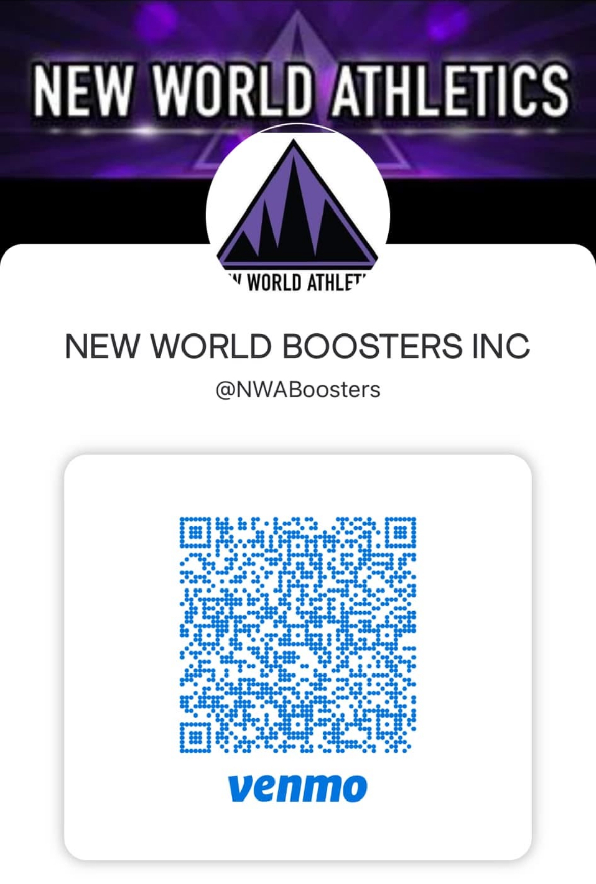
New World Booster Inc.
Venmo

Slide 8
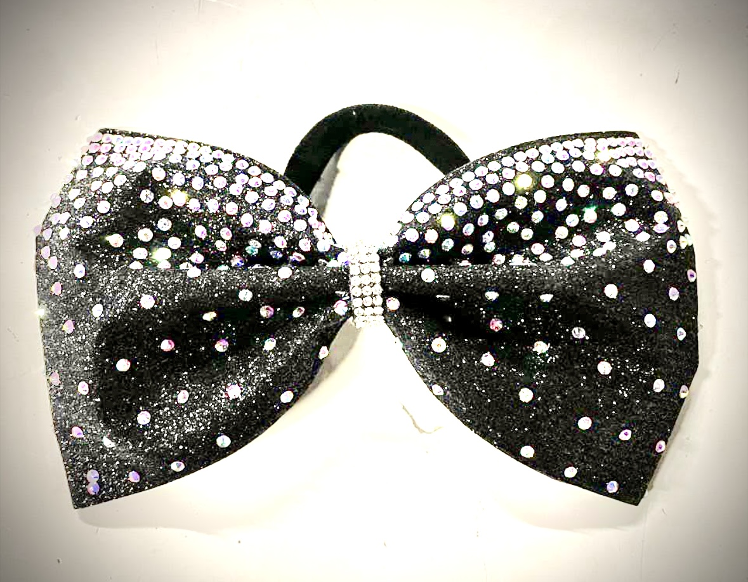
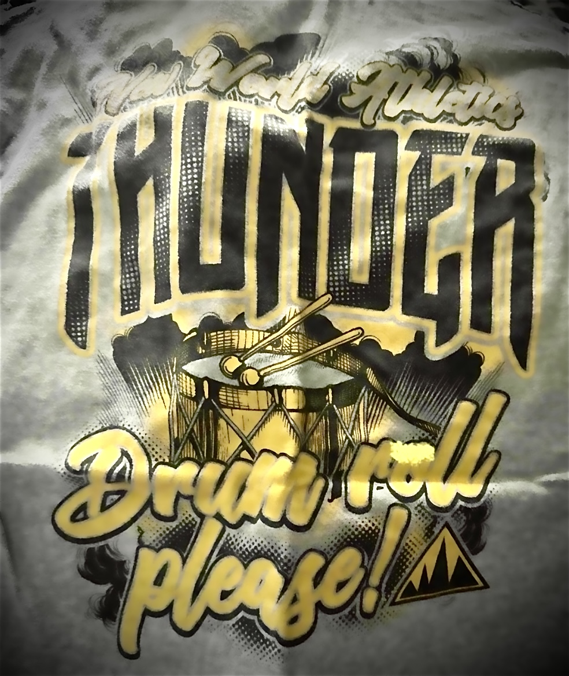
Supporting our Athletes
Members receive at least one mandatory gift such as bows, team t-shirts, etc.
Bows
Team T-Shirts

Slide 9

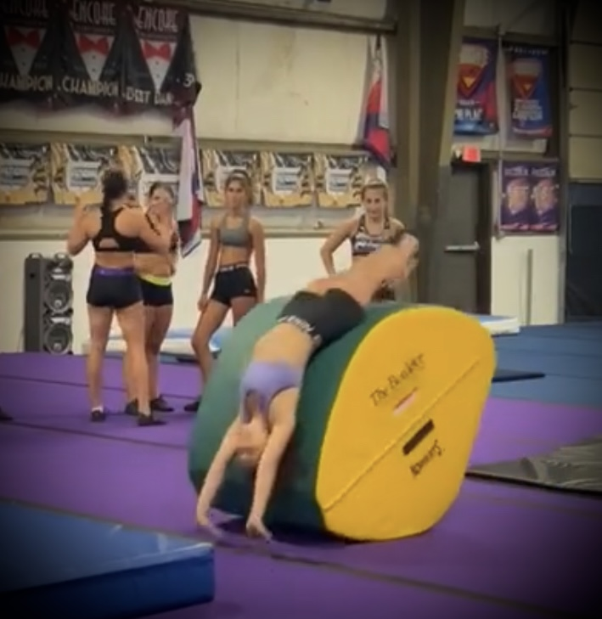
Supporting our Athletes
End of Year Banner
Gym Equipment
Commemorating the season, while supporting athletes by providing essential gym equipment for skill development.

Slide 10
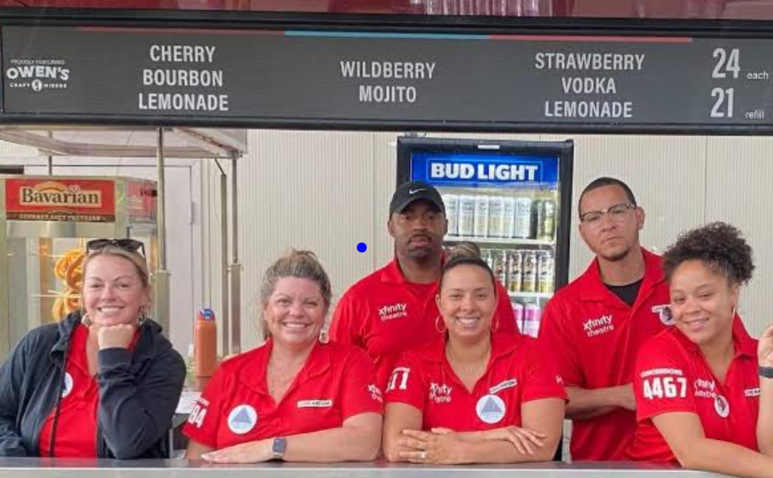
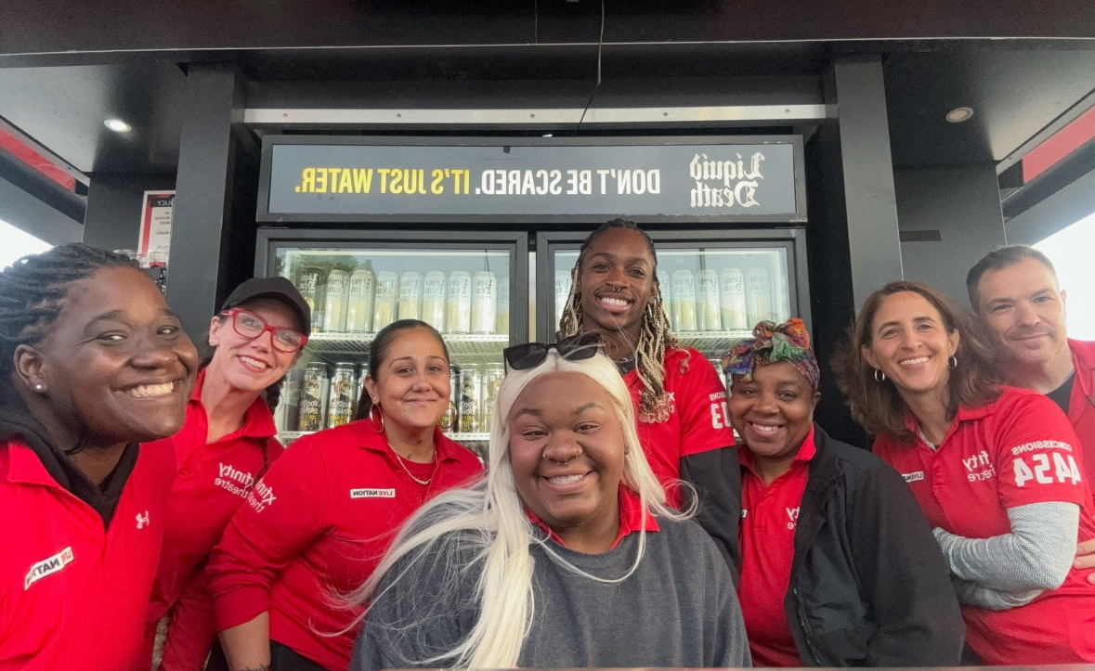
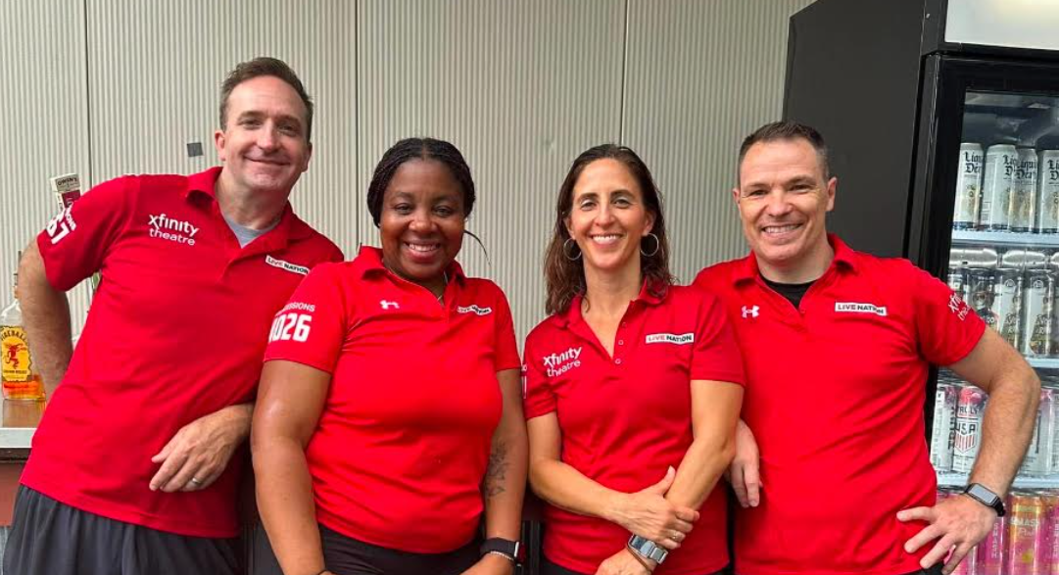
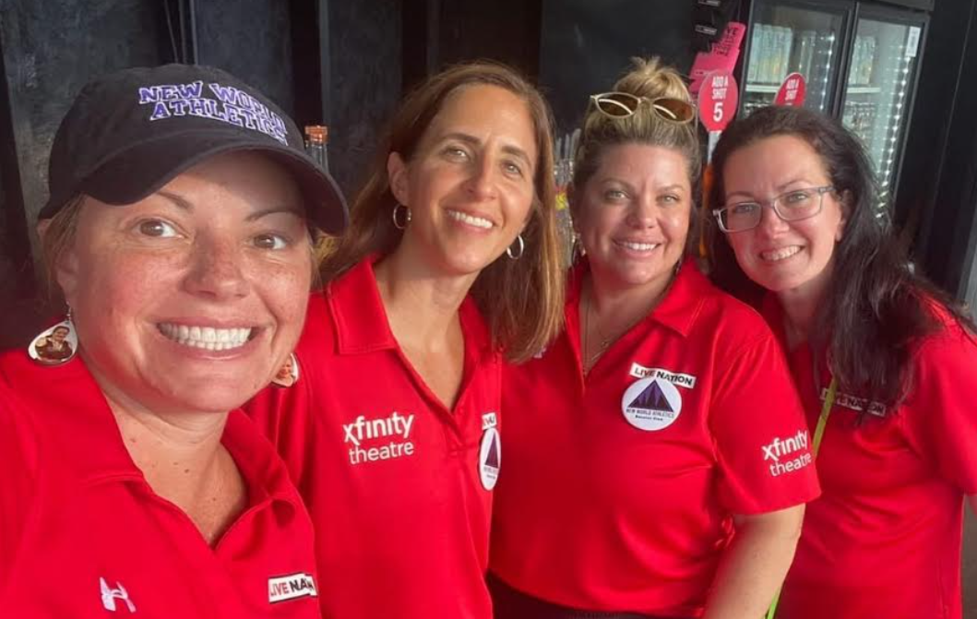
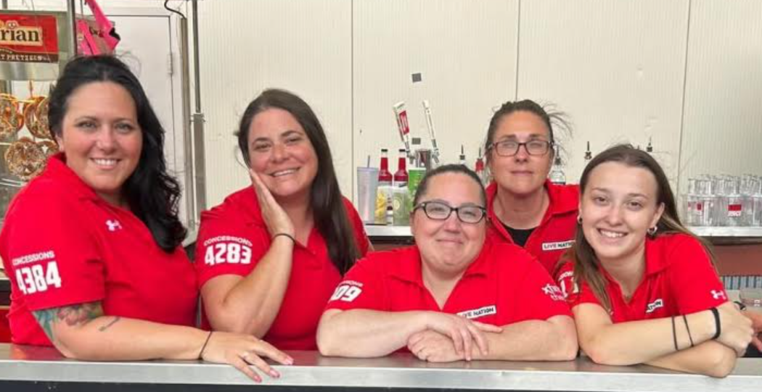
Concerts, Concerts, Concerts
Booster Club helps organize and manage concert fundraisers to support our athletes
We start the season with concerts
May-September
We have contracted with Xfinity Theatre A Live Nation Venue
All participants must attend mandatory concert meeting
complete our concert contract and Xfinity waiver.
Currently Posted Upcoming Events
Creed – Summer of ‘99 Tour - Tues Jul 22nd
Nelly with Ja Rule, Eve & Special Guests - Sat Aug 2nd
Let’s go where the music is too loud!
Concert like there’s no tomorrow!

Slide 11
Concerts, Concerts, Concerts
Everyone has their thing; concerts are our thing!
Financial Information to Inform and Encourage Participation
You say music: I say a concert!
Get ready to concert ‘til you drop!

Slide 12
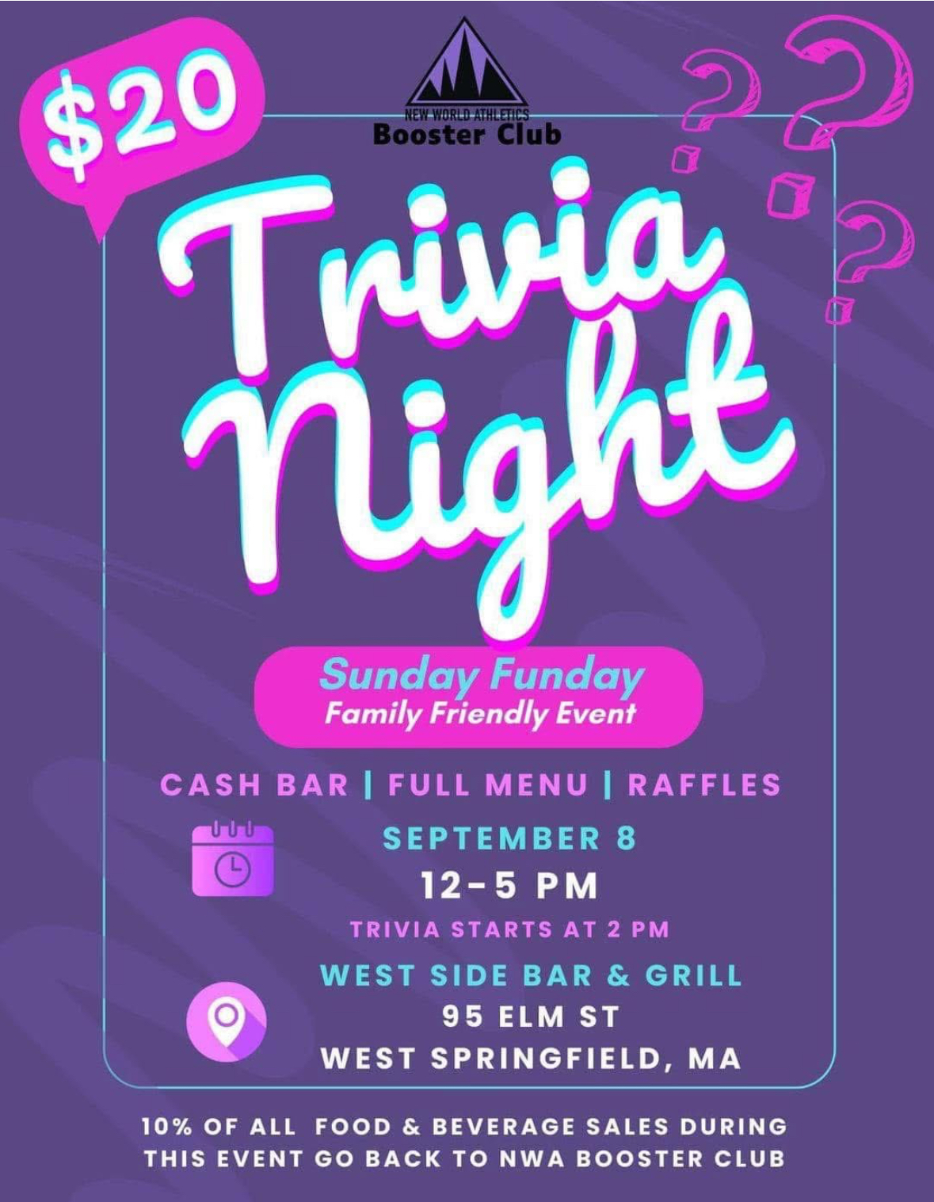
Booster Club Fundraisers/
Events
Trivia Night

Slide 13



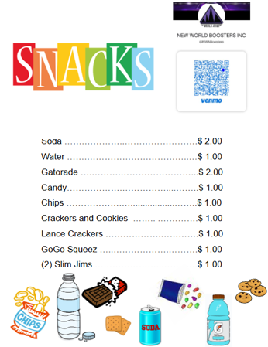





Booster Club Fundraisers/
Events
Showcase
(Lesson Raffle & Snack Sales)

Slide 14

Booster Club Fundraisers/
Events
Gym Wide Holiday Party

Slide 15
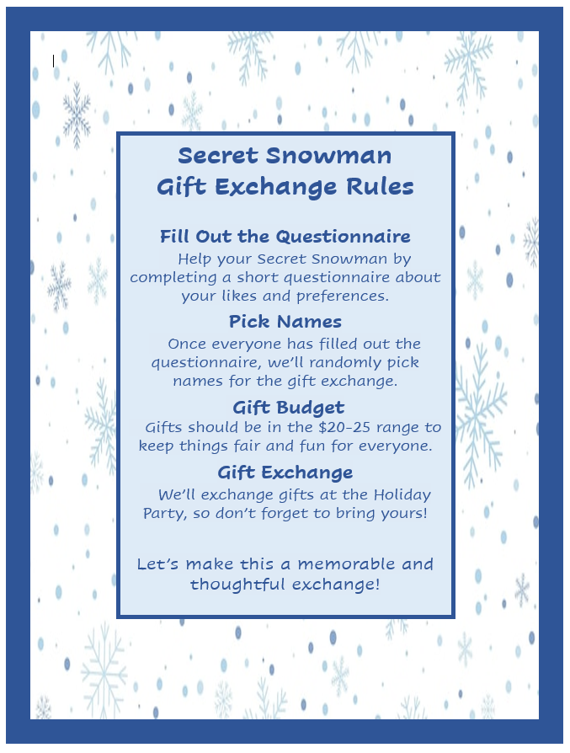
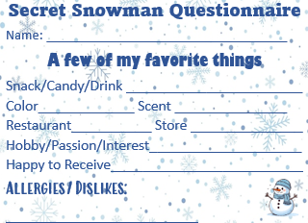
Secret Snowman

Slide 16
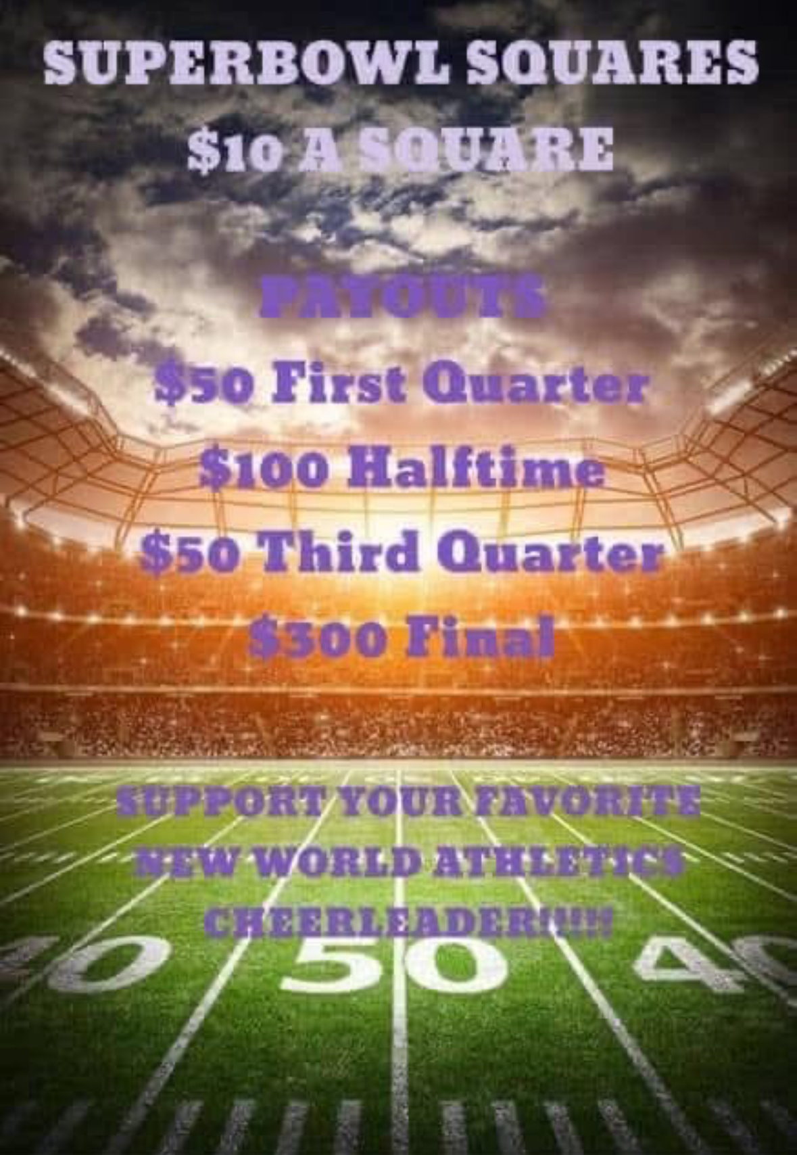
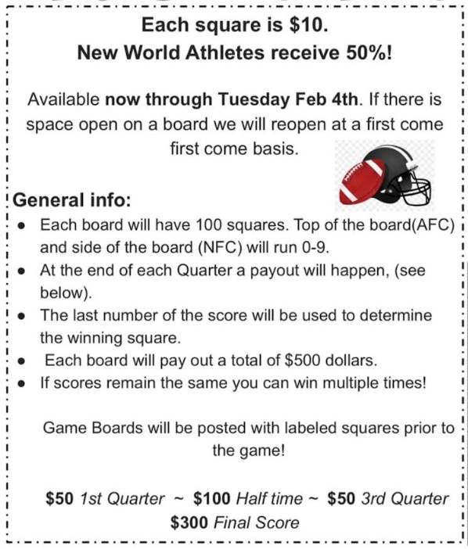
Booster Club Fundraisers/
Events
Superbowl Squares

Slide 17

Booster Club Fundraisers/
Events
Support My Squad

Slide 18
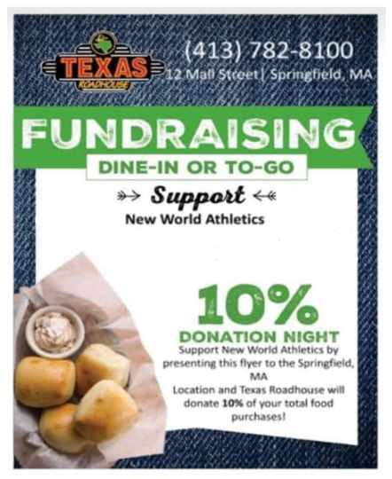

Booster Club Fundraisers/
Events
860-413-3473
3 Turkey Hills Rd Suite 3L East Granby, CT
5% of sales from open to close
Dine-IN or TO-GO
Home - Tj’s Burritos

Slide 19
Booster Club Meeting Schedule
2024-2025
2025-2026
6/13/24 - Thursday 7p
7/10/24 – Wednesday 7p
8/8/24 – Thursday 7p
9/11/24 – Wednesday 7p
10/10/24 – Thursday 7p
11/13/24 – Wednesday 7p
12/12/24 – Thursday 7p
1/8/25 – Wednesday 7p
2/27/25 – Thursday 7p
5/7/25 – Wednesday
End of Season Mtg/Nominations
6/4/25
7/25
8/25
9/25
10/25
11/25
12/25
1/26
2/26
3/26
4/26
5/26 End of Season Mtg/Nominations
Tentative Schedule Subject to Change

Slide 20
Gym Owners & BOD Meeting Schedule
2024-2025
2025-2026
10/30/24 – Booster Board Mtg 6p
11/9/24 – Tea & Jordan 9a
1/5/25 – Tea & Jordan 930a
2/5/25 – Booster Board Mtg 6p
3/2/25 – Tea & Jordan 930a
6.1.25 – Tea & Jordan
9.25 – Booster Board Mtg
10.25 – Tea & Jordan
12.25 – Booster Board Mtg
2.26– Tea & Jordan
3.26 – Booster Board Mtg
Tentative Schedule Subject to Change

Slide 21
Membership Eligibility:
    All members must be an active member of New World Athletics.
    New members of the club must pay a membership fee of $40 per athlete plus $10 for each additional athlete.
    Membership eligibility will be terminated Immediately after the season ends on May 31st. Access to the booster club social media page and band app will be removed, and ability to participate in fundraisers will be terminated if a renewal registration hasn’t been completed and dues have not been paid by June 15th.
    Booster Club fee is due immediately upon sign up and is non-refundable seven (7) days after payment is received.
    Partial year members may join at any time during the current season.

Slide 22
Membership Levels:
    Full Year Membership (All Star Cheer Program)
      - Must be a member of a year-round cheer team.
      - Active full year members must attend a minimum of 4 meetings in-person per season to maintain active membership status. Failure to do so will result in the forfeiture of any end of season bonuses or gifts paid for by the Booster Club if one is awarded. Special committee meetings do not count towards the required meetings.
    Partial Year Membership (Half Year Cheer Program)
      - Must be a member of a partial year cheer team.
      - Active partial members must attend a minimum of 2 meetings in-person per season to maintain active membership status. Failure to do so will result in the forfeiture of any end of season bonuses or gifts paid for by the Booster Club if one is awarded. Special committee meetings do not count towards the required meetings.

Slide 23
Become part of the team!
  The elected Board of Directors shall hold office for two (2) year terms.
  The ballot shall be submitted (such as e-mailed, and posted on the website), to the voting members by May 31st or not less than 30 days before the designated deadline. 31st.
  Election of Board of Directors shall take place at a meeting set by the board of directors on or prior to May 31st.
  Elected Board of Directors will take effect June 1st of the current year. Prior Board of Directors must turn over all Booster club items to newly elected Board of Directors within one week after election.

Slide 24
Fundraising
Fundraising activities will be selected by majority vote.
The fundraising chairs for each fundraiser shall decide how funds will be distributed with approval from the BOD by majority vote of members present at the regular meeting.
In all fundraising events the total profit will be calculated and 5% will be deducted for the Booster Club for future fundraising events or operating expenses.
All registered NWABC members (one per athlete) will have an equal opportunity to work a fundraiser.
Prior to working any fundraiser, a code of conduct form must be signed and submitted. A code of conduct should be provided with initial member registration.
A fundraising documentation form must be completed and submitted to the NWABC Board and approved prior to the start of the fundraiser. All information regarding ongoing fundraisers must be shared at regular monthly meetings.

Slide 25
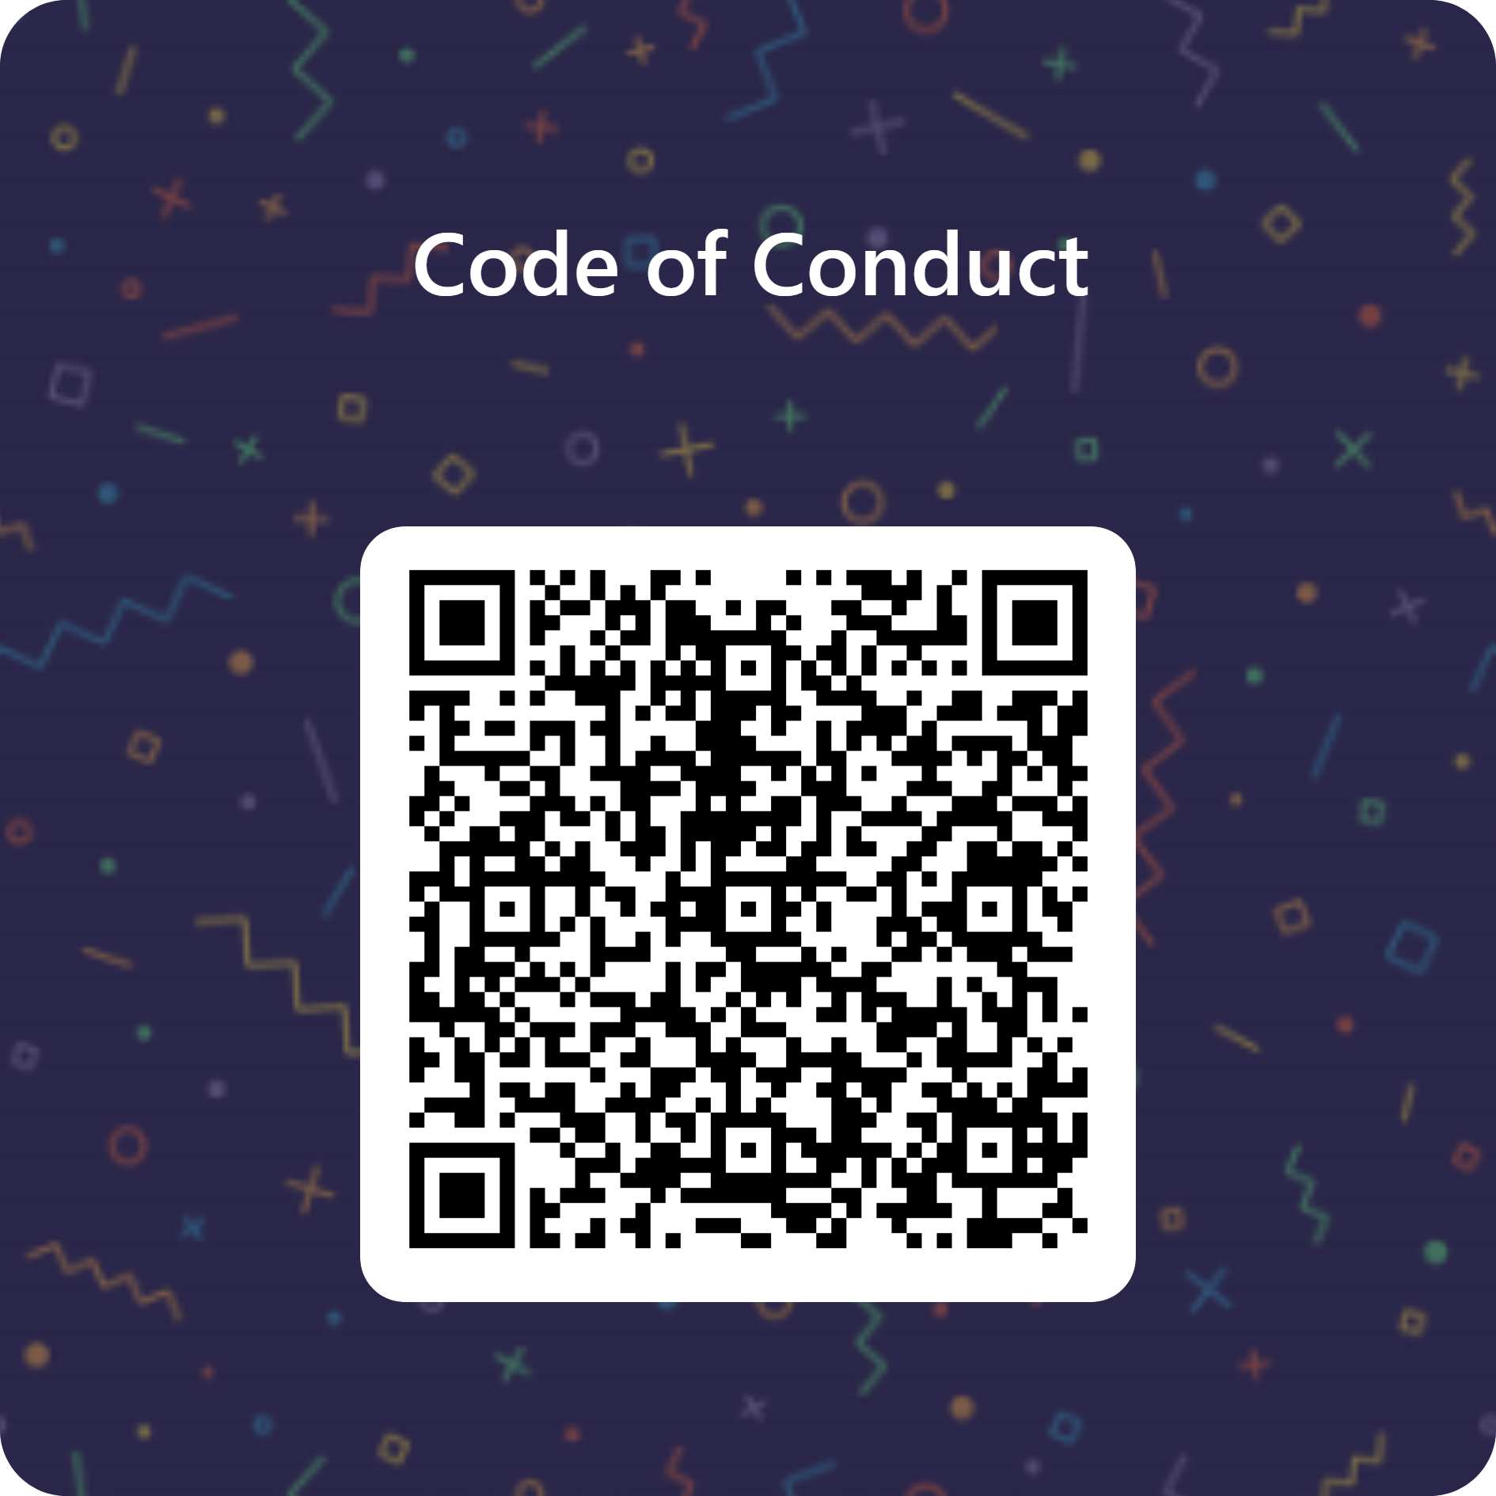
code of conduct form
https://forms.office.com/r/RH9AVC51Bw

Slide 26
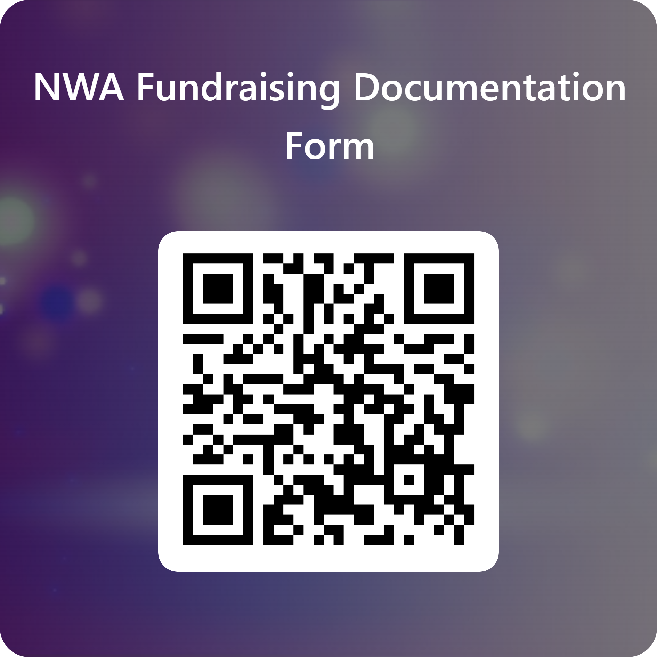
fundraising documentation form
https://forms.office.com/r/LWiqA4eAe8

Slide 27
Fundraising
  Any and all monies earned through fundraising under the NWABC shall be applied to the athlete’s account at New World Athletics first and will be held at the New World Athletics location by its proprietors only.
    If an athlete’s account is in good-standing and paid in full with NWA then any additional monies earned through fundraising under NWABC may be applied to other specific athlete related expenses such as Worlds/Summit/End of Season Competition fees.
  Any athlete/member that withdraws from New World Athletics program will immediately be terminated as member of the NWABC and will forfeit any and all monies earned from fundraising through the NWABC. All forfeited money shall remain with NWABC.
  Any “sponsor” monies paid to the NWABC will be assessed a 5% fee. The NWABC will not be responsible for making individual sponsorships public. Any “sponsor” fees for the gym will be split among all booster club member athletes in good standing equally. Gym sponsors will be mentioned at events by name.

Slide 28
Reimbursement
  As a non profit 501(c)3, NWABC is designed to exist to support New World Athletics athletes and is eligible to apply fundraising monies to non-private shareholders.
  An athlete must be in good standing with New World Athletics before applying for any expense reimbursements.
    All membership fees, competition fees, music fees, camp fees, added lesson expenses, pro-shop expenses or any other New World Athletics account balance must be paid in full at the time that they are due to be considered in good standing.
  Athlete accounts that are in good standing with New World Athletics, may apply for the below expenses to be reimbursed.
  The expense must have already occurred before any reimbursement will be approved.
  Lodging expenses within the approved timeline for distant and local competitions. Any lodging that is shared between athletes will only be reimbursed to the owner of the expense.
  Airfare expense for the athlete and one travel companion if the athlete is under the age of 21 years old.
  End of Season Competition fees for the athlete only.

Slide 29
Reimbursement
    Request for reimbursement of an approved expense will only be accepted after expense and travel, if applicable, has occurred.
    Required documentation includes:
      - Documentation from New World Athletics gym owners that the athlete account is in good standing.
      - A completed request for reimbursement form
      - A detailed invoice of expense
      - A redacted statement of payment showcasing ONLY the credit card company name and expense transaction that will align with the detailed invoice.

Slide 30
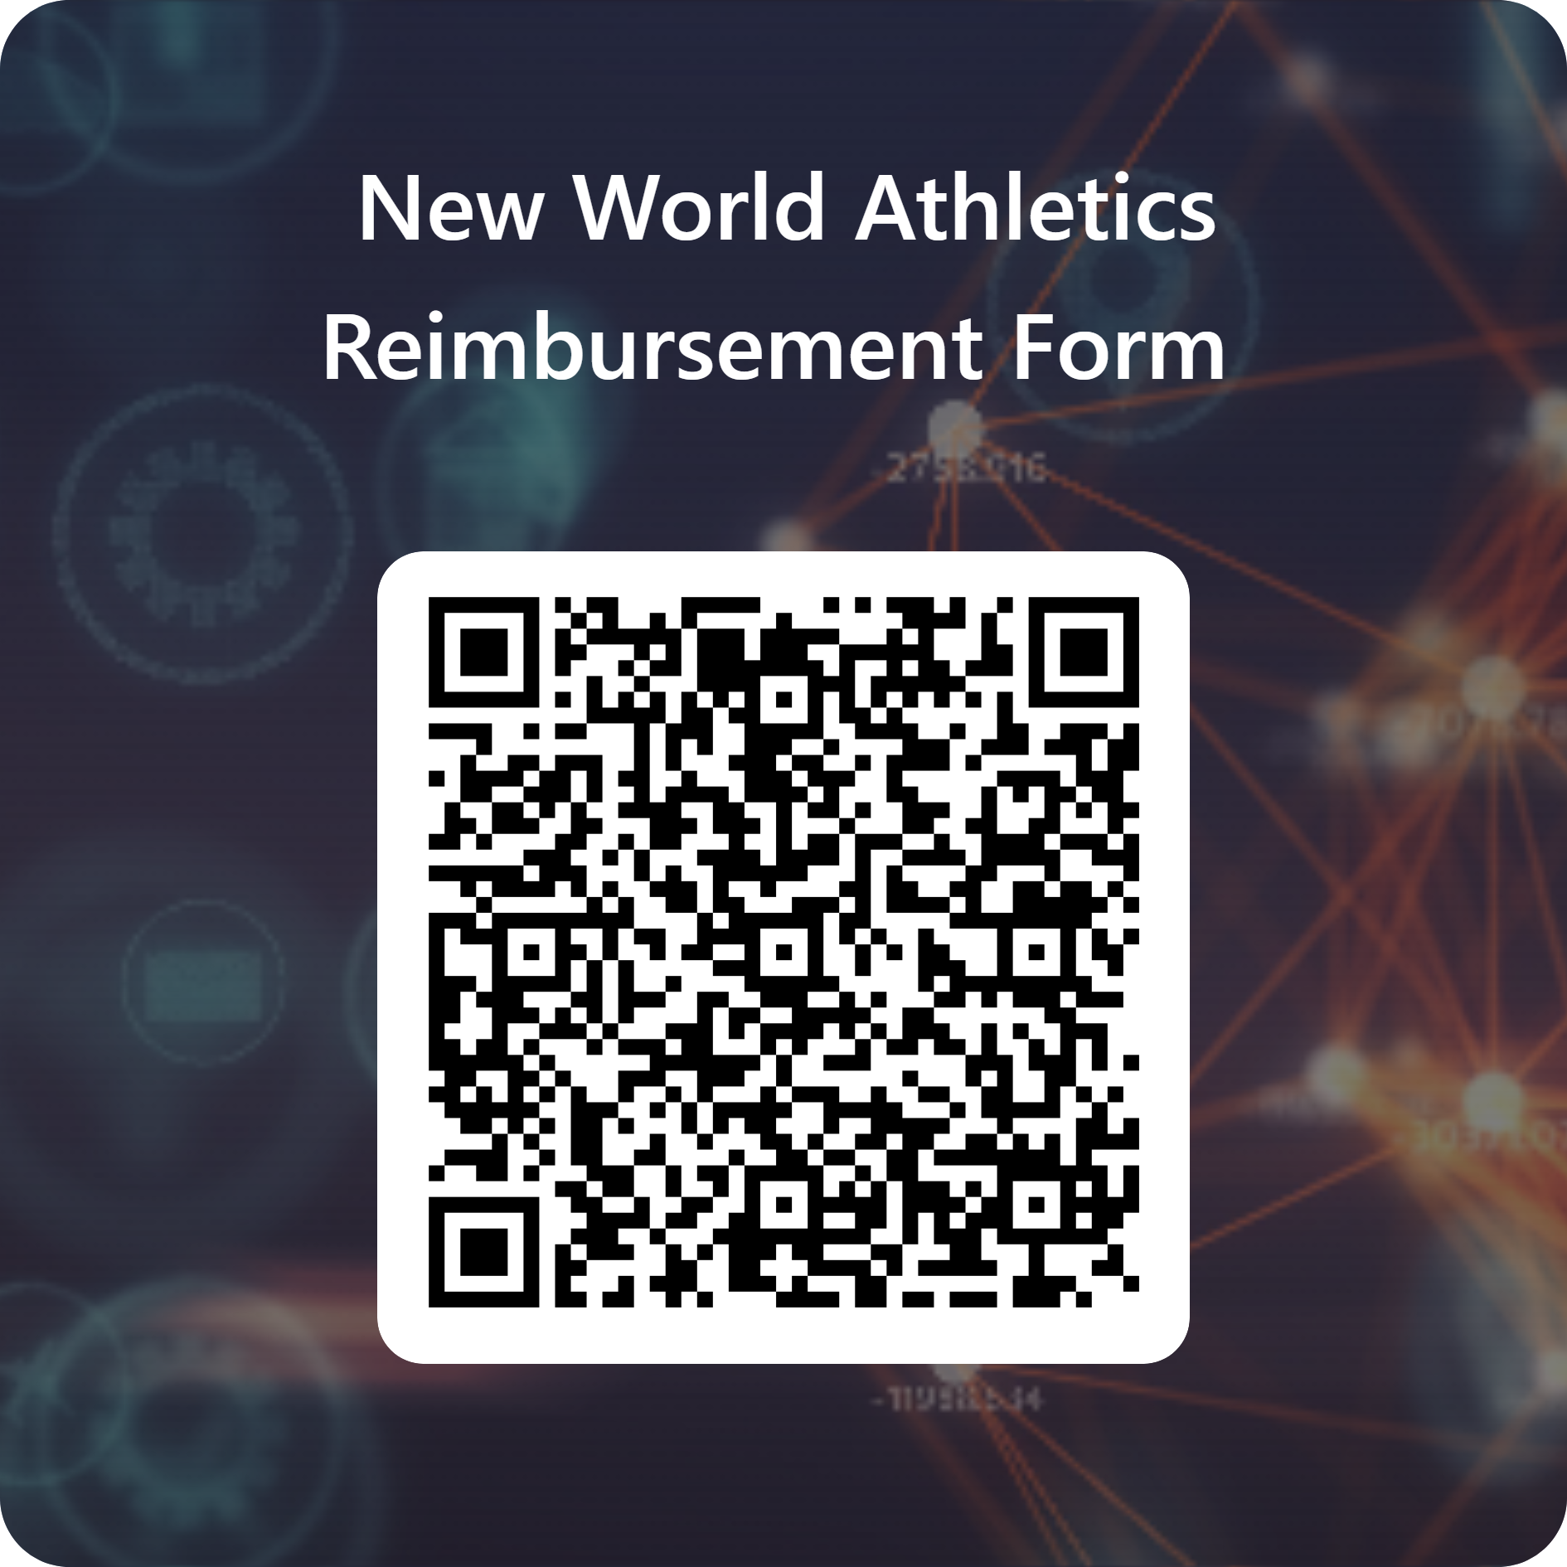
reimbursement form
https://forms.office.com/r/LWiqA4eAe8

Slide 31
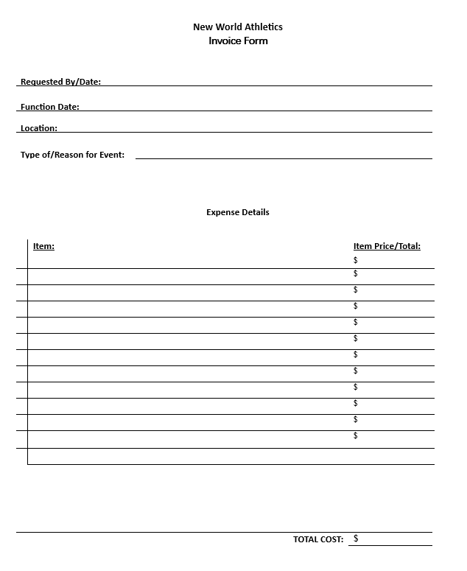
invoice of expense

